Slide 1

CSE 317: Artificial Intelligence
Markov Models
[These slides were created by Dan Klein and Pieter Abbeel for CS188 Intro to AI at UC Berkeley. All CS188 materials are available at http://ai.berkeley.edu.]
Notes:
.

Slide 2
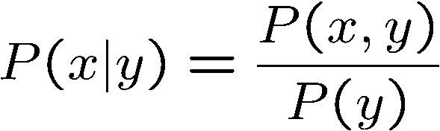

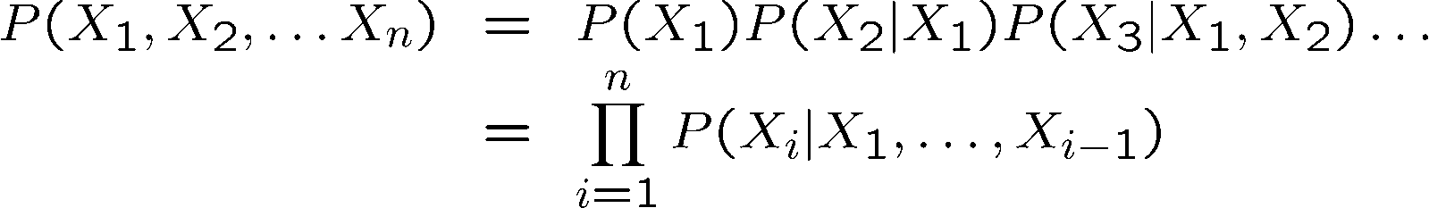

Probability Recap
Conditional probability
Product rule
Chain rule
X, Y independent if and only if:
X and Y are conditionally independent given Z if and only if:

Slide 3
Markov Models

Slide 4
Reasoning over Time or Space
Often, we want to reason about a sequence of observations
Speech recognition
Robot localization
User attention
Medical monitoring
Need to introduce time (or space) into our models

Slide 5


Markov Models
Value of X at a given time is called the state
Parameters: called transition probabilities or dynamics, specify how the state evolves over time (also, initial state probabilities)
Stationarity assumption: transition probabilities the same at all times
Same as MDP transition model, but no choice of action!
X₁
X₂
X₃
X₄

Slide 6
Joint Distribution of a Markov Model
X₁
X₂
X₃
X₄
Joint distribution:
More generally:
Questions to be resolved:
Does this indeed define a joint distribution?
Can every joint distribution be factored this way, or are we making some assumptions about the joint distribution by using this factorization?

Slide 7
Chain Rule and Markov Models
X₁
X₂
X₃
X₄
From the chain rule, every joint distribution over can be written as:
Assuming that
and
results in the expression posited on the previous slide:

Slide 8
Chain Rule and Markov Models
X₁
X₂
X₃
X₄
From the chain rule, every joint distribution over can be written as:
Assuming that for all t:
gives us the expression posited on the earlier slide:

Slide 9
Implied Conditional Independencies
X₁
X₂
X₃
X₄
We assumed: and
Do we also have ?
Yes!
Proof:

Slide 10
Markov Models Recap
Explicit assumption for all t :
Consequence, joint distribution can be written as:
Implied conditional independencies: (try to prove this!)
Past variables independent of future variables given the present
i.e., if or then:
Additional explicit assumption: is the same for all t

Slide 11
Conditional Independence
Basic conditional independence:
Past and future independent of the present
Each time step only depends on the previous
This is called the (first order) Markov property
Note that the chain is just a (growable) BN
We can always use generic BN reasoning on it if we truncate the chain at a fixed length

Slide 12
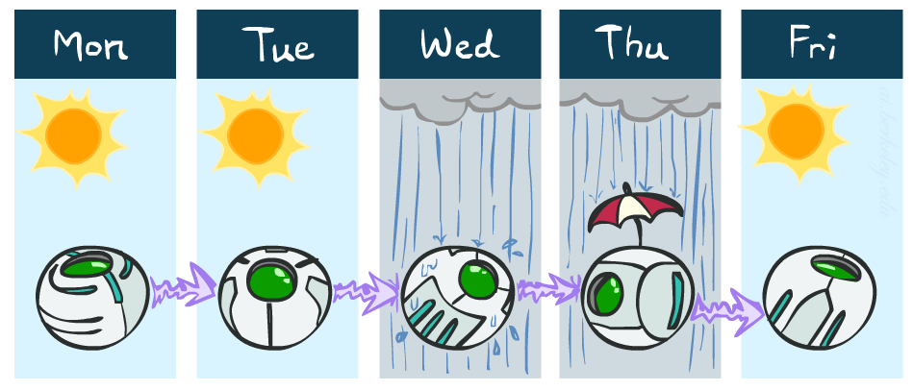
Example Markov Chain: Weather
States: X = {rain, sun}
Initial distribution: 1.0 sun
CPT P(X_{t} | X_{t-1}):
Two new ways of representing the same CPT
X_{t-1} | X_{t} | P(X_{t}|X_{t-1})
sun | sun | 0.9
sun | rain | 0.1
rain | sun | 0.3
rain | rain | 0.7
0.9
0.3
0.9
rain
sun
sun
sun
0.1
0.3
rain
rain
0.7
0.7
0.1

Slide 13
Example Markov Chain: Weather
0.9
Initial distribution: 1.0 sun
What is the probability distribution after one step?
0.3
rain
sun
0.7
0.1

Slide 14
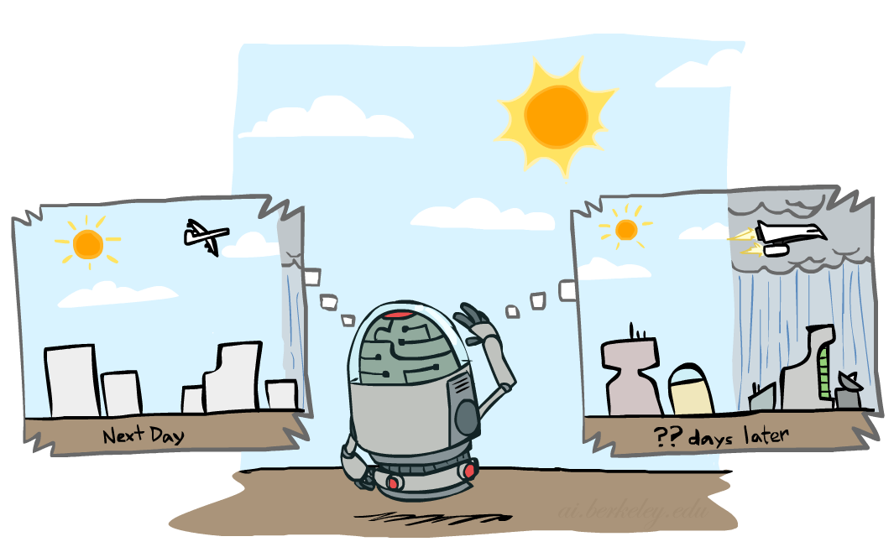

Mini-Forward Algorithm
Question: What’s P(X) on some day t?
X₁
X₂
X₃
X₄
Forward simulation

Slide 15
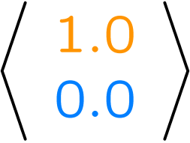
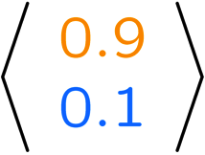
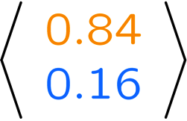
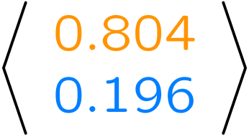
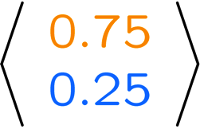
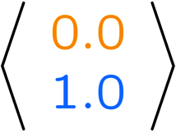
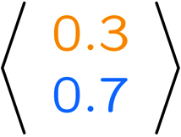
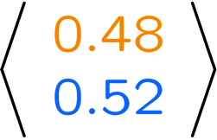
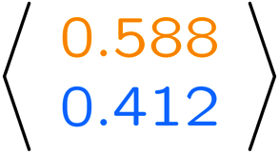
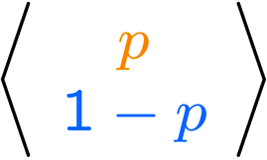
Example Run of Mini-Forward Algorithm
From initial observation of sun
From initial observation of rain
From yet another initial distribution P(X₁):
P(X₁)
P(X₂)
P(X₃)
P(X₄)
P(X∞)
P(X₁)
P(X₂)
P(X₃)
P(X₄)
P(X∞)
…
P(X₁)
P(X∞)
[Demo: L13D1,2,3]

Slide 16

Stationary Distributions
For most chains:
Influence of the initial distribution gets less and less over time.
The distribution we end up in is independent of the initial distribution
Stationary distribution:
The distribution we end up with is called the stationary distribution of the chain
It satisfies

Slide 17
Example: Stationary Distributions
Question: What’s P(X) at time t = infinity?
X₁
X₂
X₃
X₄
X_{t-1} | X_{t} | P(X_{t}|X_{t-1})
sun | sun | 0.9
sun | rain | 0.1
rain | sun | 0.3
rain | rain | 0.7
Also:

Slide 18
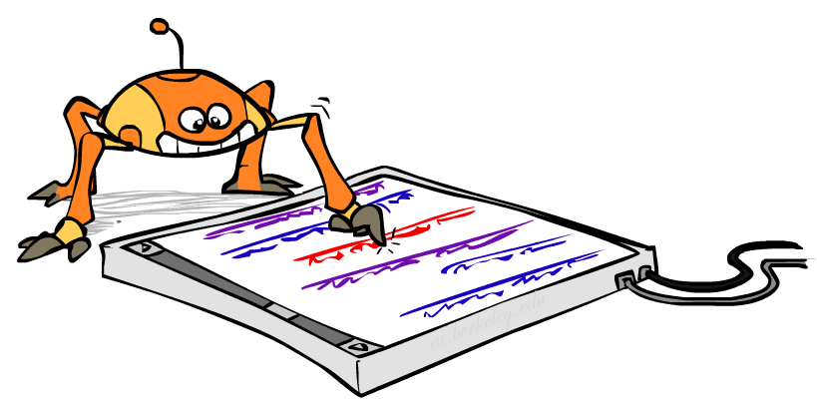
Application of Stationary Distribution: Web Link Analysis
PageRank over a web graph
Each web page is a state
Initial distribution: uniform over pages
Transitions:
With prob. c, uniform jump to a
random page (dotted lines, not all shown)
With prob. 1-c, follow a random
outlink (solid lines)
Stationary distribution
Will spend more time on highly reachable pages
E.g. many ways to get to the Acrobat Reader download page
Somewhat robust to link spam
Google 1.0 returned the set of pages containing all your keywords in decreasing rank, now all search engines use link analysis along with many other factors (rank actually getting less important over time)
Notes:
Before: most search engines were merely based on how well a page matches your search words.
Note: currently dominated by clickstreams

Slide 19

Application of Stationary Distributions: Gibbs Sampling*
Each joint instantiation over all hidden and query variables is a state: {X₁, …, X_{n}} = H U Q
Transitions:
With probability 1/n resample variable X_{j} according to
P(X_{j} | x₁, x₂, …, x_{j-1,} x_{j+1}, …, x_{n,} e_{1,} …, e_{m})
Stationary distribution:
Conditional distribution P(X₁, X₂ , … , X_{n}|e_{1,} …, e_{m})
Means that when running Gibbs sampling long enough we get a sample from the desired distribution
Requires some proof to show this is true!

